Slide 1
Application Software
Project
By: Kanav Khanna

Slide 2
Aim: To write an algorithm to provide shortest route to public transport commuters using a combination of Delhi Metro and Uber.

Slide 3
Step 1: Determining the parameter to base algorithm on
After studying surveys available, I concluded that time is the most important parameter for commuters.
I also inferred that in Delhi shortest routes aren’t always the quickest

Slide 4
Step 2: Creating Google APIs
I used the following Google APIs in the algorithm:
Directions API
Distance Matrix API
Geocoding API
Geolocation API
Maps Elevation API
Places API
Roads API
Time Zone API

Slide 5
Step 3: Studying Floyd Warshall Algorithm and learning JSON
Step 4: Writing Algorithm

Slide 6
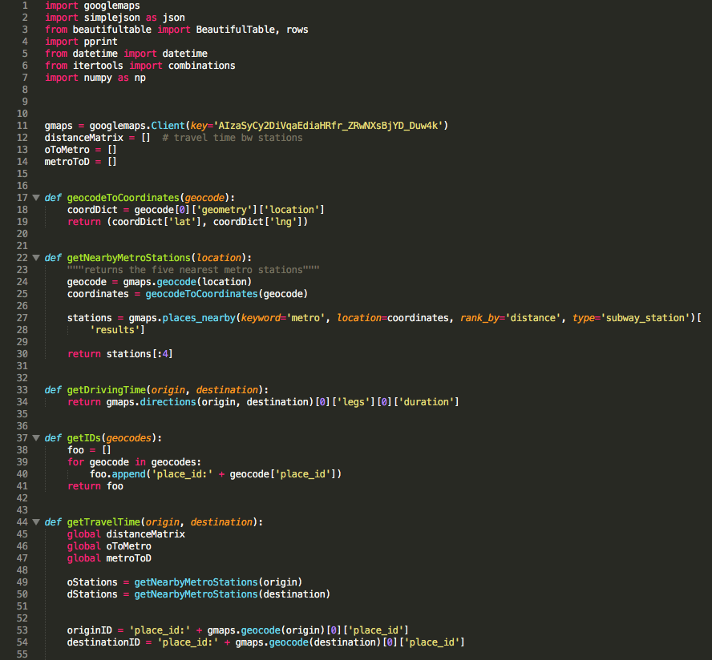

Slide 7
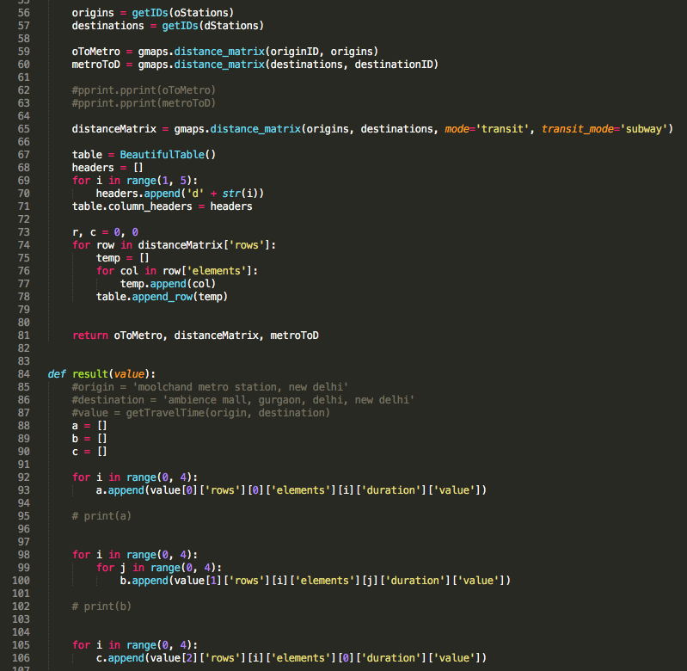

Slide 8
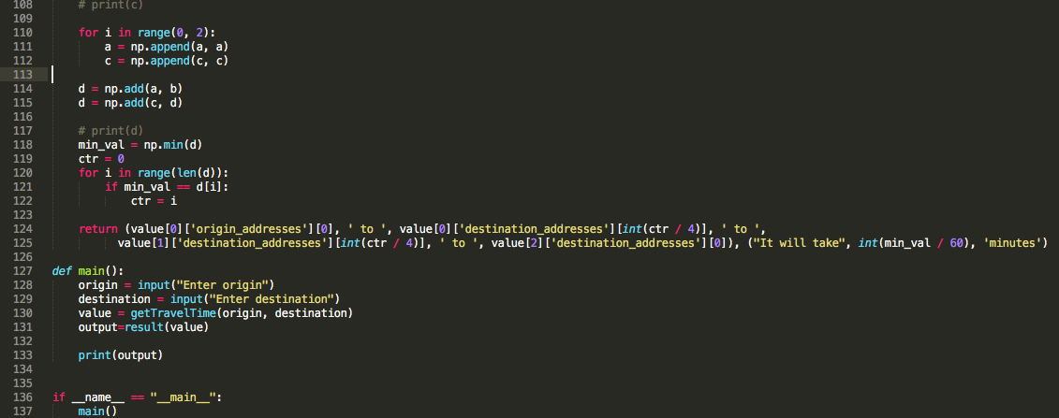

Slide 9
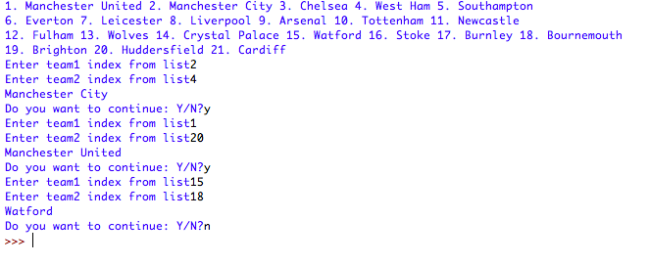
Output

